Slide 1


Technical Interview Workshop

Slide 2
http://bit.ly/techvanguard

Slide 3


Who we are
Jess Tang
Software Developer
Natasha Meinzen
Software Developer
Notes:
Both

Slide 4
Stages of an Interview
Apply
Phone Screen
Technical Screen
Onsite Interview
Notes:
Jess

Slide 5
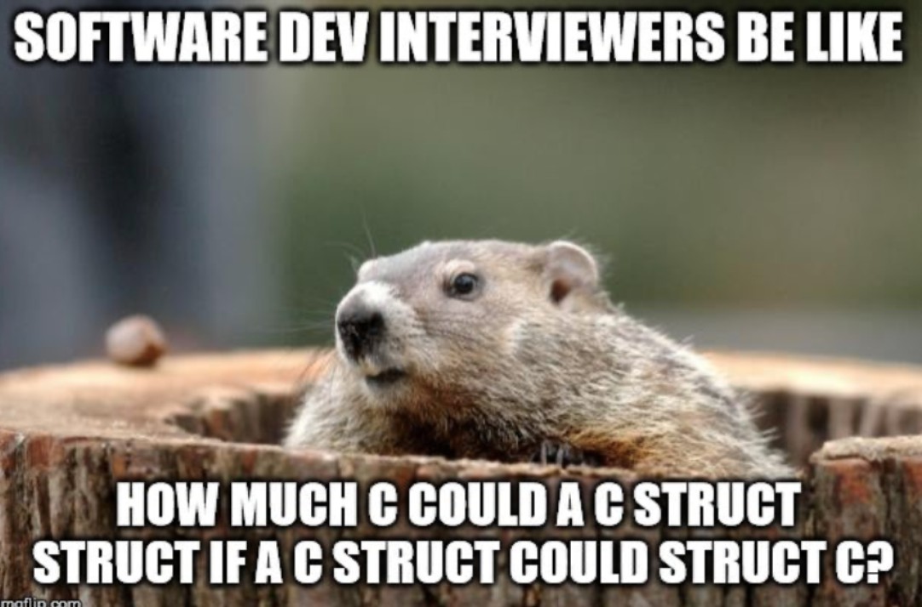
What is a technical interview?
Used to assess technical ability
Many of technical interviews (our focus: coding assessment)
Coding assessments
Brain Puzzles
Debugging
System Design
Notes:
Jess

Slide 6
Why is a technical interview important?
Shows how you tackle real-world problems.
Interviewers are looking for:
Problem-solving skills
Testing code as you write it
Enthusiasm/ Teamwork
Communication skills
Notes:
Natasha

Slide 7
What to do during a technical interview
State which programming language you will use unless told a specific one
Ask clarifying questions before writing code
Speak clearly and precisely
If you’re stuck:
Stay calm
Think out loud
Try new ideas
Notes:
Natasha

Slide 8


Technical Interview approach
Brute Force Solution
Consider edge cases
Optimize solution
Explain implementation
Notes:
Jess

Slide 9

Gold Bar Interview Question
You have one gold bar. For seven days, you must pay your employee with the value of one gold segment each day. Breaking the bar only twice, how can you ensure the employee gets paid appropriately?
Notes:
Jess

Slide 10
Instructions for Activity
Task: Choose a problem to solve in 20 mins
Make some friends!
Join your breakout room
Choose which problem you want to do
Get out of your comfort zone
Talk out loud
Use scratch paper when possible
Use the approaches we talked about
Feel free to look at solutions when you are finished!
Notes:
Natasha

Slide 11
2 Interview Questions
Given an array of integers, return indices of the two numbers such that they add up to a specific target.
You may assume that each input would have exactly one solution, and you may not use the same element twice.
leetcode.com/problems/two-sum/
Given a string, determine if it is a palindrome, considering only alphanumeric characters and ignoring cases.
Note: For the purpose of this problem, we define empty string as valid palindrome.
leetcode.com/problems/valid-palindrome/
* As of June 30, 2018.

Slide 12
Common Must Study Topics
Data Structures
Big O Notation
Trees
Sorting and search algorithms
Heaps
Arrays
Hash tables
Dynamic Programming

Slide 13
Advice collected from completing 30+ Interviews
Study!
Focus on one or two programming languages
The interviewer wants you to succeed
Ask all clarifying questions before proceeding
Don't be afraid of admitting you're stuck
Slow down, take your time, think it through
Always look over entire job description before interview

Slide 14
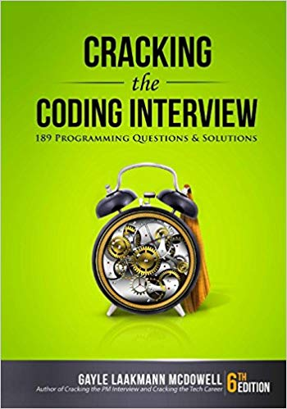



Resources

Slide 15
Stay in touch! Add us on LinkedIn
Jess Tang
https://www.linkedin.com/in/jessrosetang/
Natasha Meinzen
https://www.linkedin.com/in/natasha-meinzen-a8b62a111/
Notes:
Both

Slide 16
Thank you.
vanguardjobs.com
All investing is subject to risk, including possible loss of principal.
Advice services are provided by Vanguard Advisers, Inc., a registered investment advisor, or by Vanguard National Trust Company, a federally chartered, limited-purpose trust company.
© 2020 The Vanguard Group, Inc. All rights reserved.

